Slide 1

MCC-CTO IIT Crash Course
IIT Start-up and Operational Guidance
Tuesday, August 20, 2024
Presenter: Rana Mckay, MD; Ramez Eskander, MD; Julia Appelt

Slide 2
What is an IIT?
A clinical trial in which the investigator conceives the research, develops the protocol, and serves as sponsor investigator
Obligations of a sponsor investigator include both those of a sponsor and those of an investigator: creating, coordinating and conducting the study.
Sponsor responsibilities:
  Ensure the trial is conducted following the general investigational plan laid out in the protocol.
  Managing the IND or IDE if applicable
Investigator responsibilities:
  Ensure the trial is conducted according to applicable regulations, including IRB, FDA, and protecting the safety, rights and welfare of subjects

Slide 3
Key Steps to Executing an IIT
The idea
Study Design
Collaboration with Others
Funding!
Trial Operations
Data Analysis and Publication

Slide 4
The Idea…
Identify an unmet need
Do your homework and know your disease site inside and out
Review clinicaltrials.gov to identify potential complementary or competing trials
Review industry portfolio and work with local MSL to identify potential areas of alignment or priority areas for an industry partner
OK to think BIG!

Slide 5
Study Design
Make a 10 min slide deck of key elements
  Rationale
  Hypothesis
  Objectives/endpoints
  Schema
  Eligibility Criteria
  Statistical Design

Slide 6
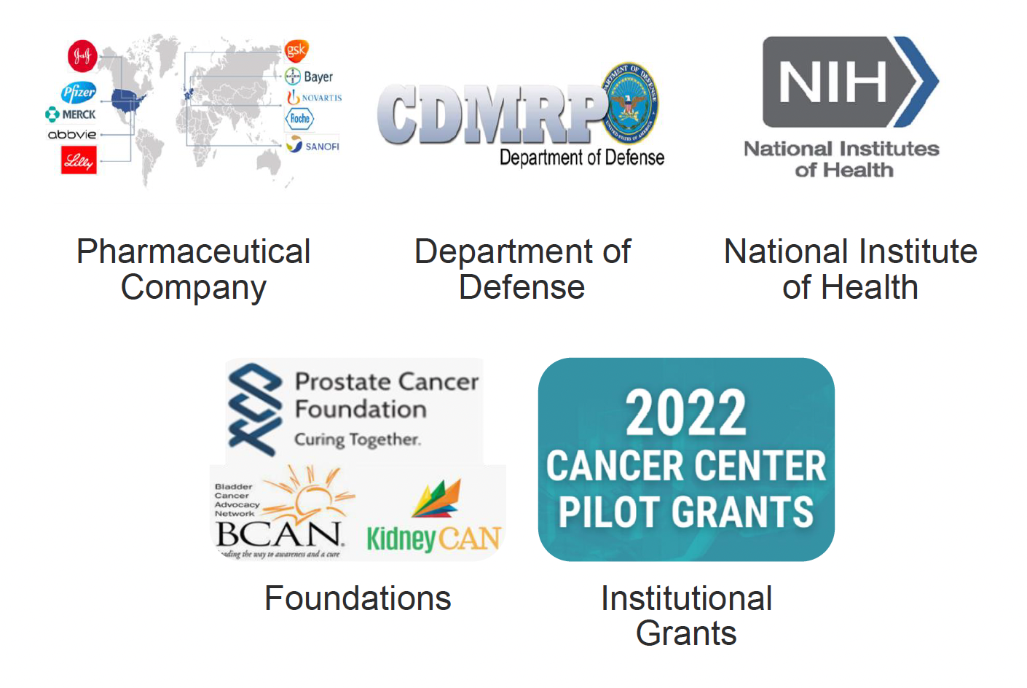
Funding…

Slide 7
Developing a Budget
Things to consider:
  Operations (study complexity)
  Number of patients
  Time that the trial will be open to accrual
  Study duration (time the trial will remain open overall)
  Number of sites
  Study assessments/procedures
Please review the budget with our internal budget team using UCSD IIT template early in the process

Slide 8
UC San Diego Health Sciences
Moores Cancer Center: Clinical Trials Office
IIT and Activation UNIT
Julia Appelt
Asst. Director, Clinical Trial Activation and IIT Support
IIT Unit
Protocol Development Officer (PDO)
Multi Site Management Lead (MSML)
Regulatory Affairs IND Specialist
Activation Unit
Start Up Project Managers
Start Up Project Manager Role:
Responsible for coordinating and managing clinical trials start up activities until study activation.
PDO Role:
Supports development and revisions of protocols for UCSD IITs
Helps with ICF and other study document creation
Submits and maintains study on clinicaltrials.gov
MSML Role
Oversees UCSD authored multi-IIT study sub-sites:
  - Site selection
  Multi site data management
  Study site meetings
  SAE reporting
IND Specialist Role
Refer to Regulatory Team chart

Slide 9
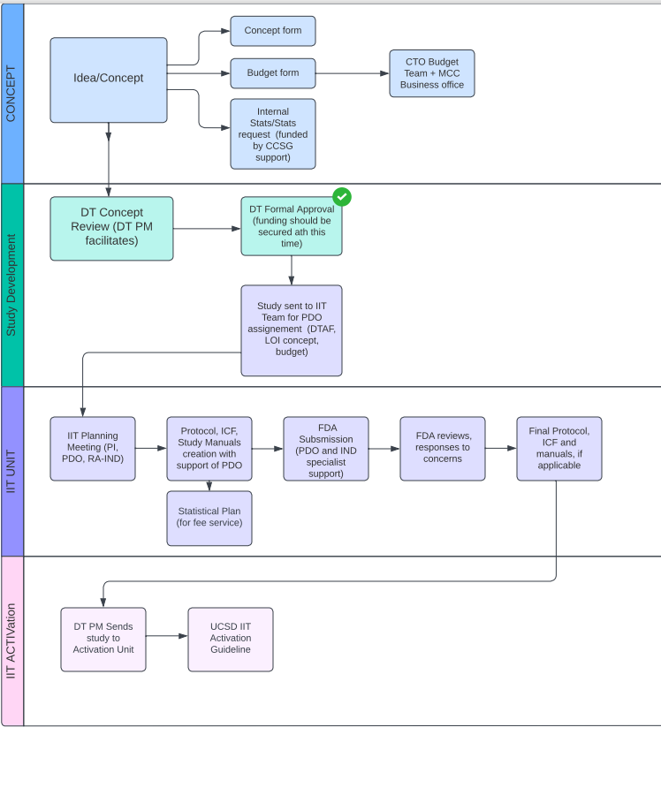
IIT Start up Overview

Slide 10

IIT Unit– Concept Development and Approval
PI completes IIT Concept Form
PI completes IIT Budget form
PI completes internal statistical request form (no fee basis):
  https://moorescancercenter.ucsd.edu/research/shared-resources/biostatistics/index.html

Slide 11
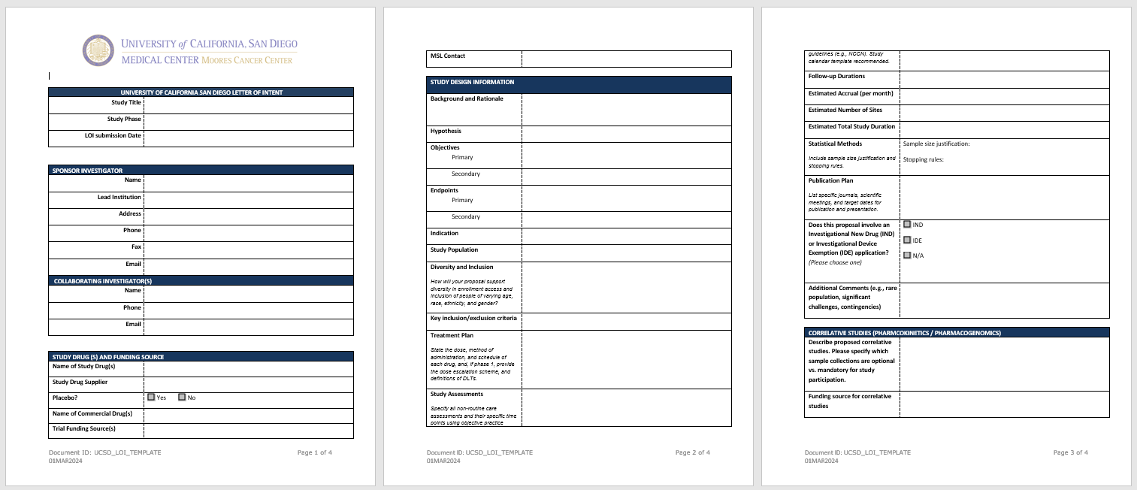
IIT Concept Form

Slide 12
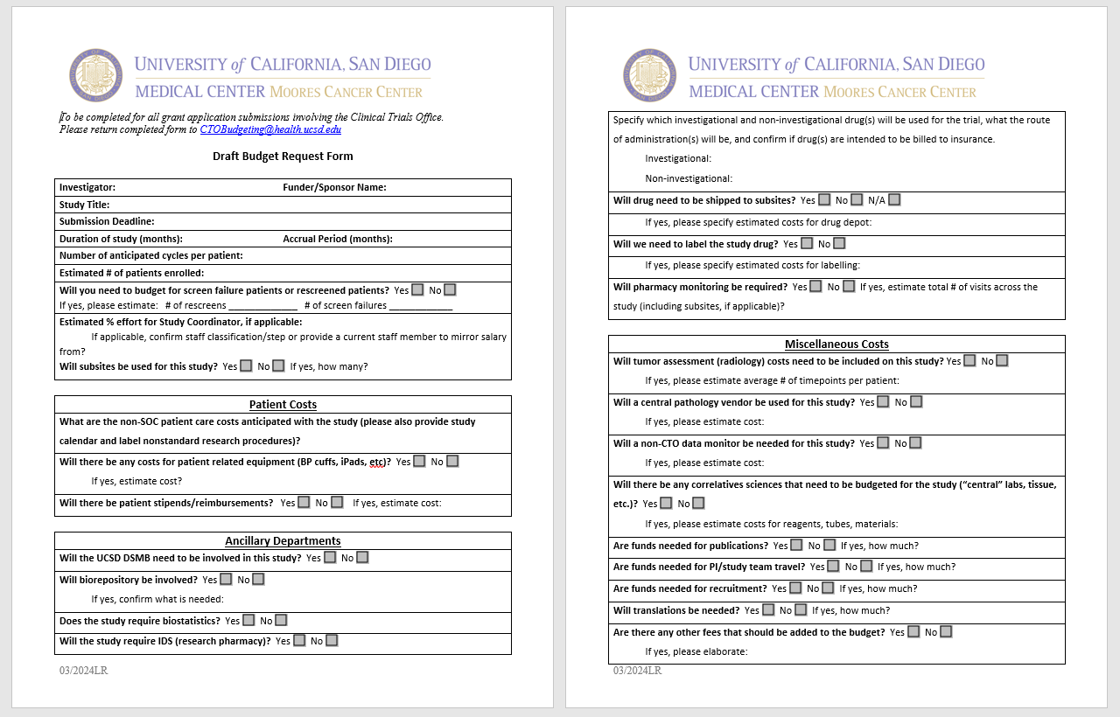
IIT Budget Form

Slide 13
IIT Unit– Concept Development and Approval
DT Concept Review: PI presents concept to the disease team
Approval
Further concept development/refinement
Reject
Formal DT Review and Approval and secured funding are required for study to proceed:
DT PM/DT CA sends study for voting
Favorable DTAF, study can proceed to IIT Unit

Slide 14
IIT Unit - Protocol Development
DT PM submits DTAF, LOI concept, and budget to IIT Unit for PDO Assignment: CTOInvestigatorInitiatedTrials@health.ucsd.edu
It is expected that the study PI will begin drafting the study protocol using existing templates prior to engagement with the PDO
PDO helps with:
  - Protocol development with PI. OIA IIT Protocol Template: https://irb.ucsd.edu/researchers/formsinstruc.html
  - Appendices development with PI
  - Manual generation (laboratory, pharmacy, imaging, pathology and other as necessary)
  -Informed Consent in collaboration with assigned Regulatory Associate
Statistical analysis plan is developed with either internal or external statistical support
  - Remember this requires funding…

Slide 15
IIT Unit- Protocol Development
Document Sign Off:
  - Principal Investigator and Steering Committee if applicable
  - Protocol Development Officer
  - Regulatory (informed consent)
  - Statistician (internal or external)
  - Quality Assurance (Data Safety Monitoring Plan, adverse event reporting)
  - Pharmacy (if needed)
  - Nursing (if needed)
  Funder (if applicable)
IND Specialist prepares FDA application, if applicable:
  - A formal IND Exemption is required for applicable studies
  - PI to review FDA provided guidance materials: https://www.fda.gov/drugs/types-applications/investigational-new-drug-ind-application
  - IND Specialist and PDO will work with PI to respond to FDA questions

Slide 16
Protocol and Study Documents Finalized
Study is considered ready for submission to the Activation Unit:
  Final Protocol
  Consent form
  Manuals (pharmacy, lab, etc.)
  Funding secured
  IND determination (formal IND exemption is required, if applicable)
  CTA template (if applicable)
  Strategy for case report form development (Velos, RedCap, other)
Disease Team Project Manager submits finalized documents to Activation Unit
  (Refer to the “New Activation Study Request Guide”.)
Welcome to the Activation Unit!

Slide 17
Basics of IND Applications
Tuesday, August 20, 2024
Presenter: Regulatory Affairs Manager
Dr. Jessica Warbrick, NMD, MSc

Slide 18
Agenda
General RA Team Overview
IND submission Requirements
IND RA Workflow
Team Expectations

Slide 19
General RA Team Overview

Slide 20
UC San Diego Health Sciences
Moores Cancer Center: Clinical Trials Office
Regulatory Team
GENERAL OVERVIEW
Jessica Warbrick
Regulatory Affairs Manager
Manage Regulatory Affairs Team (SU RA and DT RA)
Create Training Materials for all regulatory (SU RA, DT RA and IND)
Create/Update/Standardize Regulatory Process Templates, SOPs, WIs and workflows
Develop and maintain Regulatory Monday.com Boards
Provide Regulatory Support for all RA (SU, DT, IND)
Escalate regulatory issues for all RA (SU, DT, IND)
Regulatory Coordinator Trial Scope
IND for single patient/expanded access
Therapeutic
Non-therapeutic
IND/IDE exempt
Investigator- Initiated Trial (IIT) Therapeutic and non-therapeutic (sIND)
Cooperative Group
Hybrid Trial
Commercially Sponsored Trial
UC Consortium Trial
Quality Improvement Project
IND Specialist Trial Scope
Initial IND submission to FDA for IITs
Initial IND submission to FDA for IND Exemption for IITs
IND Specialist Role
Submit FDA FORM 1572
Trial Activation through Closure
Initial ICF negotiations
Submission for initial IRB approval
PRMC submission
Other ancillary submissions as required per study (IBC, HERC)
Attendance in SIV
Update initial study status in Velos
Amendments
Annual reviews/FDA submissions
DOA logs
Velos status changes
Start Up RA Role
Initial ICF negotiations
Submission for initial IRB approval
PRMC submission
Other ancillary submissions as required per study (IBC, HERC)
Attendance in SIV
Update initial study status in Velos
Disease Team RA Role
Amendments (protocol, IB, ICF, other)
Annual reviews
DOA logs
Velos status changes

Slide 21
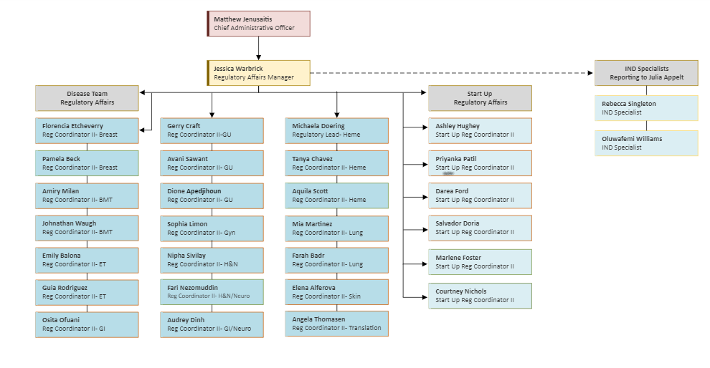
Regulatory Affairs Team: Current

Slide 22
IND Submission Requirements

Slide 23
Submitting the IND Application to FDA
Appendices to Include in Initial IND Application:
Letter of Authorization to cross-reference IND XXXXX and Manufacturer XXXX
Protocol
Informed Consent Form
Curriculum Vitae
FDA Form 1572
FDA Form 3674
Environmental Assessment
Packaging Label
Investigator's Brochure
Note: This same list of documents is required when submitting to obtain formal IND Exemption.
Reference: MCC CTO_IND Manual

Slide 24
More Information: IND Application Procedures: Overview
Each application should be accompanied by:
  Form 1571 (PDF - 830KB) (IND application cover),
  Form 1572 (PDF - 718KB) (Investigator’s statement), and
  Form 3674 (PDF - 3MB) (certification requirement & mandatory registration and reporting of results for applicable clinical trials through ClinicalTrials.gov.
While IND application sponsors are not required to submit information regarding clinical investigators’ financial interests or arrangements in the original IND applications, they are expected to collect this information before a clinical investigator participates in a clinical study. For further information refer to Guidance for Clinical Investigators, Industry, and FDA Staff: Financial Disclosure by Clinical Investigators (PDF - 165KB).
Reference: IND Application Procedures: Overview | FDA

Slide 25
More Information: IND Application Procedures: Overview
Upon receipt of an IND application, FDA will notify the sponsor of the date it receives the application through an IND acknowledgment letter.
  An IND application may go into effect:
    30 days after FDA receives the application, unless FDA notifies the sponsor that the investigations described in the application are subject to a Clinical Hold; or
    on earlier notification by FDA that the clinical investigations in the IND may begin.
Once an IND application is in effect, a drug manufacturer may ship the investigational new drug to the investigator(s) named in the application. An investigator may not administer an investigational new drug to human subjects until the IND application goes into effect.
Reference: IND Application Procedures: Overview | FDA

Slide 26
More Information: IND Application Procedures: Overview
In addition to knowing the requirements for safety and other reporting, investigators submitting IND applications should be familiar with procedures pertaining to the following:
  Exemptions from IND application submission requirements.
  Interactions with FDA.
  Procedures related to Clinical Hold.
  Responsibilities of Investigators.
Reference: IND Application Procedures: Overview | FDA

Slide 27
IND RA Workflow

Slide 28
IND Studies RA Workflow
IND Specialist Assigned
IND Specialist Prepares Submission
IND Specialist Submits to FDA
FDA provides IND Approval or IND Exemption
IND Approval- IND specialist retains study through lifecycle

Slide 29
IND Exempt Studies RA Workflow
IND Specialist Assigned
IND Specialist Prepares Submission
IND Specialist Submits to FDA
FDA provides IND Approval or IND Exemption
IND Exemption Obtained- study transferred to Start Up (SU) RA in Activation Unit
SU RA transfers study to Disease Team (DT) RA after study is activated

Slide 30
Team Expectations

Slide 31
Expectations of Regulatory Team
24-48 hour turn around time for responses to emails
  If RA does not have the answer then they are to respond with “received” to the message and provide an estimated date in which they will have a response to the sponsor/PI
Available via Teams 9 AM to 4:00 PM PT M-F (Core Hours)
Set email out of office (OOO) if not working
Send an OOO calendar appointment/meeting invite to Reg Manager, PM (SU or DT)
  Find coverage for urgent issues for planned OOO
For SU RA- if missing Activation Meeting- send status of trial to SU PM in advance
→ Regulatory Manager holds RA Team accountable to these standards.

Slide 32
Expectations of Sponsors (PIs for IITs)
24-48 hour turn around time for responses to emails
  RA will follow up after 2 business days and Cc RA Manager
    RA manager will follow up if we still do not receive a response
      Follow up options include:
        Email
        Phone call/voicemail with follow up email documenting call or voicemail
This applies to all emails sent to sponsor/PI for any requested documents, review of documents, scheduling or any other information required to get the study submitted to FDA, activated or maintained.
These expectations are effective for all clinical trials in the Activation Unit and at the Disease Team level.

Slide 33
Key Takeaway
PIs, please communicate to the Regulatory Team if you have any questions.
If you do not receive a response in 48 working hours- please include myself: jwarbrick@health.ucsd.edu
My cell: 714-580-1832

Slide 34


Slide 35
Navigating the Nuances: Essentials of Operationalizing Investigator Initiated Clinical Trials
Budgeting – Lara Rose

Slide 36
CTO Budgeting Workflow – PI Requests Study Estimate
PI completes IIT questionnaire
Budget Analyst drafts estimation and provides to PI
PI finds funding and receives award
FDA provides IND Approval or IND Exemption
Study is assigned to Activation Unit.
Analyst updates internal budget based on CA and determines if there are shortfalls.*
*S1 write-offs and shortfalls will need to be reviewed by leadership for approval based on updated financial memo.

Slide 37
CTO Budgeting Workflow – Business Office Proposals
Business Office will notify CTO Budgeting of new proposal involving clinical trial and request PI to complete IIT questionnaire
Budget Analyst drafts estimation and provides to PI and Business Office
Business Office will integrate the budget into the grant application.
FDA provides IND Approval or IND Exemption
PI receives grant/award
Study is assigned to Activation Unit.
Analyst updates internal budget based on CA and determines if there are shortfalls*.
*S1 write-offs and shortfalls will need to be reviewed by leadership for approval based on updated financial memo.

Slide 38
Budget Analyst Responsibilities
CA Review
  Timepoints – are all the items on the CA listed at the correct timepoints/does it match the protocol?
  Procedures – are there any procedures that are missing from the CA that should be added (or removed)?
    We may reach out to the PI to confirm these items when we are unsure, like imaging modalities and disease areas
  Modifiers – these are usually reviewed by the PM and PI
Budget Development
  Subject costs
  Administrative costs
  Invoiceable costs (procedures that may or may not happen, can also be administrative)
  Patient Stipends/Reimbursements
  Materials/Supplies
  OH Rate – depends on who is funding the trial
Negotiation, as applicable
Consistency Review

Slide 39
Funding for IITs
Industry
Grant
PI funded
Non Profit
33% OH rate
Funding can come from one or multiple sources
59% OH rate if it is a Federal Grant
No OH applied since it would be internal funding
PI would need to allocate funds into a separate account specifically for this trial.
OH rate is based on Sponsor written policy. If it does not exist, the Federally negotiated rate applies.

Slide 40
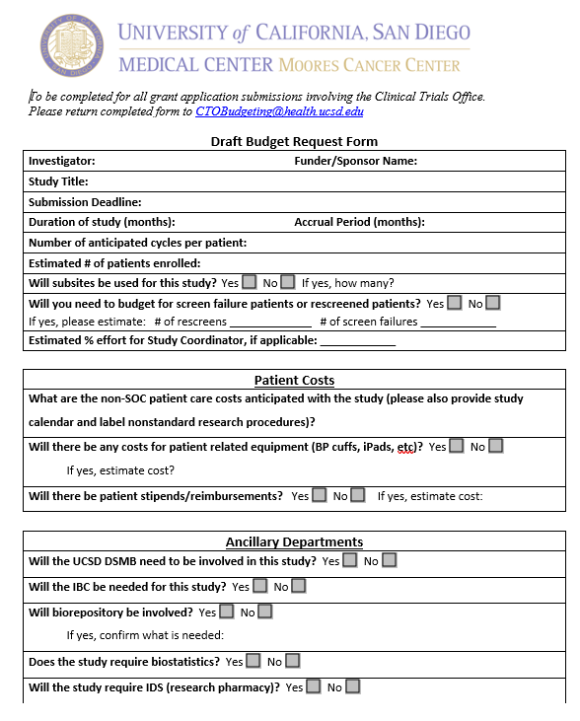
IIT Questionnaire
Common errors:
CRC effort anticipated – we will default to 25%. We also will loop in DT PM to confirm when it’s estimated to be less or if we need further confirmation.
What will be SOC or billed to study? Drugs and imaging are large costs that can make or break the budgets.
Correlatives costs – how do we collect specimen and who is processing the correlatives. If we are, what is involved?
Common sticker shock:
Radiology/RECIST – will you need readings done or will you be doing them? Frequency?
Subsites – drug shipment, drug labeling, monitoring/QA
External Departments: Biostats, IDS, BTTSR

Slide 41
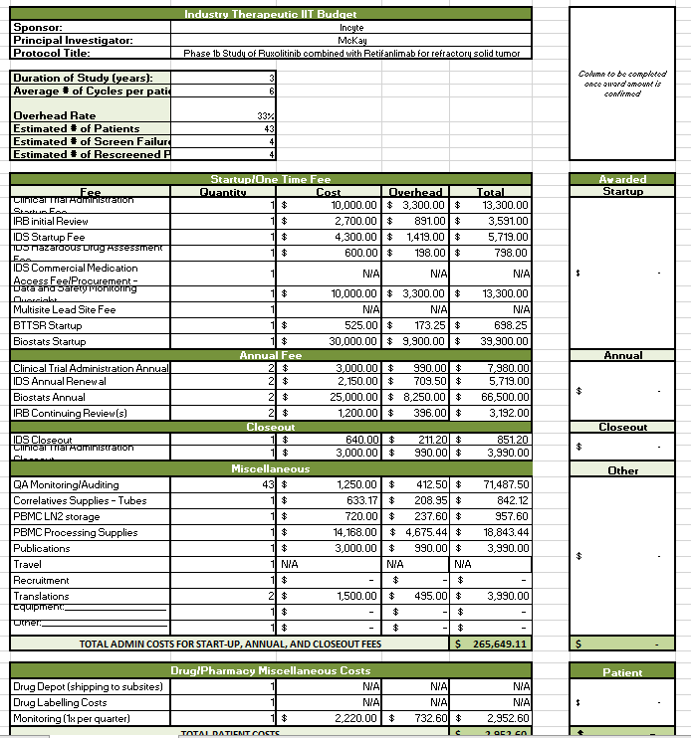
IIT Budget Example
Lines that aren’t applicable may still appear in the grid but will have a “0” quantity or be lined out to say “N/A”
Internal budget may not match a Grant Budget application.
We may reach out to you when we are having difficulty reaching Sponsors or when we aren’t coming to an agreement on the budget (or the CA)
Timelines for response from PI directly influence the timeline for the budget development/negotiation.

Slide 42
Thank you!

Slide 43
UCSD Moores Cancer Center
CTO Quality Assurance & Research Compliance
Dr. Arcadia L. Cruz, PhD

Slide 44
Overview of Today’s Session
Organizational Reporting Structure
Components of Quality Research
QA - OCP Improved Beyond Compliance to Competency
IIT Routine Monitoring Plan
IIT Audit Plan
CAPAs- Corrective Prevention Plans- KRI
Investigational Brochure & Re-consenting
Notes:
Why do research

Slide 45

Components of Quality Research- QC & QA=QMS + Compliance
Quality” is characterized by the ability to effectively and efficiently answer the intended question about the benefits and risks of a medical product (therapeutic or diagnostic) or procedure
Amalgamated: Introduction of an independent and objective audit of the QA/QC system and its outcomes
QA defines the standards to be followed in order to meet the quality requirements for a clinical trial
Quality control (QC) and quality assurance (QA)
  systems together constitute key quality systems that are parts of quality management systems (QMS)
QC ensures that these defined standards are followed at every step- Clin Ops

Slide 46
The Importance of Quality Assurance and Compliance in Clinical Research
Data Integrity Assurance
Validity, Accuracy, complete, results are consistent with the established protocols and procedures.
Safeguarding Research Subjects
Rights, safety, privacy concerns, and welfare are protected. The risks of not protecting research subjects can include physical harm, psychological harm, loss of confidentiality, loss of autonomy, and exploitation Maintaining.
This can lead to legal and ethical issues and damage the reputations of both the researchers and the institutions involved in the research.
Regulatory Compliance
Clinical research is subject to numerous regulations and guidelines that must be followed.
but also to ensure that the results are accepted by regulatory agencies.
Improving the Efficiency of Clinical Trials
Proper guidelines help identify and address potential issues in the research process before they become significant problems.
Notes:
and qualifications of trial personnel.
Compliance with GCP guidelines is essential for the acceptance of clinical trial data by regulatory agencies and the scientific community, ensuring that the results can be used to make informed decisions about the safety and efficacy of new treatments.

Slide 47
What is the Purpose of Compliance Management ?
Patient Safety
Risk Assessment/Evaluations
1
4
Sponsors Role-IIT/ UCSD- CTO (Coordinating/Leading Site)
Notifications
2
5
Identified results of monitor findings
Decisions and Actions
3
6
Notes:
What is the purpose of Quality Research
1. Provide information to academia ,Industry and Regulators
2. Provide regulators with sound information to make decision re: safety and efficacy of the disease, illness and prevention
3. Move Science forward to improve the quality of health improve outcomes, decrease mortality, improve quality of life.
4. To ensure investigators are following the protocol, following GCP and complying with regulatory requirements , entering correct and verifiable data
What is the sponsors Role?
1. Sponsors of a clinical trial monitor the progress of the clinical trials.
2. Monitors ensure that the data is accurate and carried out according to the protocol for patient protection.
3. When significant findings are identified as a result of monitoring it can be escalated for review by the sponsors to the clinical team and quality Assurance department.
4. Risk assessments are done and evaluations are conducted
5. Decisions are made regarding what actions should be taken: notifying regulatory authorities and/or ethics committees.
6.At all times safety and rights of the patient are the priority.

Slide 48

Notes:
When you think of quality assurance in clinical trials what comes to mind? How do we fit all the pieces of research together to achieve great results and patient safety

Slide 49
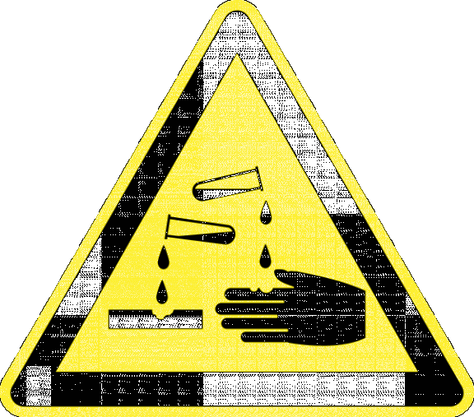
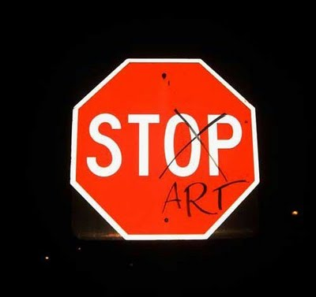





Possible Road Blocks to Quality Research?
Notes:
Identify road blocks to quality in the areas that you work in? Take a minute to think about trials you are currently coordinating?
How do you have Difficult or complex protocols? If so how do you manage them for them?
Do you feel adequately supported with education at your site to conduct your the trial?
Do you feel you able to accurately capture and identify AE SAE’s
Do you feel comfortable regarding FDA regulation and IRB Reporting?
Adequate staff to conduct the trial?
Do you have adequate PI over site in your trials
Informed consent not enough time?
Comprehension of participants.
Do you have good communication with your trial Sponsor?

Slide 50
Building the Framework for Quality
Analyze
Plan and prioritize
Control and Report
Monitor
Identify

Slide 51
Clinical Research Quality Is Designed to be Embedded Throughout the trial
1
Standard Operating Procedures
4
Informed Consent
2
Know the Protocol
5
Training/Education
3
Regulatory agency and ethics committee approval
6
Adequate monitoring and audits
Notes:
Putting plans for managing logistics in place well before the first patient is key.
SOP’s know what they are where they are: How to consent, when to report what and to who. Create new ones when you see a process that could be improved or are no longer working for you.
When is the best time to review a protocol? Site selection and pre assessment?
Informed consent: Are you transparent with the consent risk?
Training : investigator meetings. Communication with sponsor.
Adequate Recording

Slide 52
Purpose of Quality Management System- Holistic
Compliance
Training
Quality Improvement
Ensure compliance with SOPs, FDA, sponsor’s protocol and local regulatory bodies
Staff training of GCP, SOPs and federal/local regulatory requirements
Use Quality Improvement (QI) Program within the UCSD Division of Research Integrity and Compliance Office
Periodic Review
Documentation
Documentation for each study should be reviewed periodically
Utilize standardized forms and checklists to ensure complete and accurate documentation
Corrections
Audits
Deficiencies found through internal QA or sponsor monitoring visits should be corrected
Conduct periodic internal QAs/ reviews & Audits to ensure compliance
Notes:
This includes:
Who performed each task
Degree of delegation of authority by PI
How and where data were recorded
Verification of protocol adherence
How study test article accountability and dispensation are/were maintained
Communications between sponsor and PI
IRB documentation, communications and approvals

Slide 53
Compliance to Competency IIT
-Internal Monitoring Plan
-Auditing Plan
Arcadia L. Cruz, PhD

Slide 54
IIT Routine Monitoring Plan
Arcadia L. Cruz, PhD

Slide 55
IIT Routine Monitoring
Single Site- UCSD
Multi-Site- UCSD Leading Coordinating Site
CTO Leading Site
IIT
UCSD MCC
Univ. Miami
UCLA
Univ. Pennsylvania

Slide 56
Risk Based Monitoring
All the IIT-CTO studies are assigned to a risk-based monitoring framework (Level Low, Medium, High ) based on understanding of risk prior to initiation of the study. ( PRMC Level)
1
Low Risk
studies involve no IND, are observational or involve a non-drug intervention. These studies are considered a low safety risk and low regulatory burden. These studies are not monitored by the OCP-QA team.
2
Moderate Risk
studies involve no IND or are considered an IND trial with minimal safety risk. These studies may involve off-label use of an approved medication or use of a dietary supplement. The safety in the general population has been established for the agent used in these studies, and is thus lower risk, but may require regulatory compliance based on IND status.
3
High Risk
studies are defined as industry-sponsored IND trials on a new compound in phases 1, 2, or 3 of development. These studies involve the highest safety risk depending on phase, and require both rigorous Code of Federal Regulations (CFR) and Good Clinical Practice (GCP) oversight.

Slide 57
Risk Level- Routine Monitoring
Level of Risk | Monitoring Overview
Moderate Risk | Requires use of Velos eCRF for registration and reporting of Adverse Events Other types of data are not required to use Velos eCRFs Requires prospective registration of participants Requires timely submission of Adverse Event eCRFs, according to protocol Requires submission of any Adverse Events meeting expedited reporting criteria to be promptly reported to the QAM, according to protocol Semi-Annual Report and SAE review will be reviewed by DSMC as indicated in Section 4.3 of the DSMP
High Risk | Requires use of Velos for registration and reporting of all study-related data Requires prospective registration of participants Requires timely submission of all eCRFs, including Adverse Events, and will be monitored in a risk-based approach Requires submission of any Adverse Events meeting expedited reporting criteria to be promptly reported to the QAM, according to protocol Semi-Annual Report, FDA Report, safety, SAE, DLT/Dose escalation, stopping rule, protocol deviation, RNI, data set, and audit report review will be reviewed by DSMC as indicated in Section 4.3 of the DSMP

Slide 58
Visit Schedule and Frequency Table for Quality Assurance Oversight –Single or Multi-Site
Table 2- Visit Schedule and Frequency Table for Compliance Oversight –Single or Multi-Site
After First Subject Enrolled at Lead Site | Routine Monitoring Single site | Routine Monitoring Sub-Site
Within 2 weeks | Every 12 weeks (4 months) | Every 24 weeks (6 months)

Slide 59
SDV Expectations for Quality Monitoring ( Regulatory, Clinical cases, IDS)
SDV Expectations Per Subject Monitored
Informed Consent
Inclusion/Exclusion Criteria
Adverse Events
Reported Serious Adverse Events
Concomitant Meds
Primary Endpoint(s)
Secondary Endpoint(s)
IP Administration
Other data ( Investigational Brochures, lab reports, ECGs, Imaging, Diaries QOL, sample collection time points, sample storage and shipping compliance etc.)

Slide 60
Investigator’s Brochure (IB)
An Investigator’s Brochure is a collection of clinical and non-clinical data about the investigational products that are the focus of the study. The brochure should provide an ongoing insight into the clinical trial study participants during the duration of the trial.
The purpose of an Investigator’s Brochure is to provide Investigators and other crucial people involved in the trial with enough information to help their understanding of the reasons for and compliance with the key features of a clinical trial protocol including dose, dose frequency, methods of administration and safety monitoring procedures.
An IB is intended to provide the investigator with insights necessary for management of study conduct and study subjects throughout a clinical trial.
An IB may introduce key aspects and safety measures of a protocol, such as:
Dose (of the study drug),
Frequency of dosing interval,
Methods of administration, and
Safety monitoring procedures.

Slide 61
Investigator’s Brochure (IB)
Generally, the sponsor is responsible for ensuring that an up-to-date IB is made available to the investigator(s) and the investigators are responsible for providing the up-to-date IB to the responsible IRBs/IECs.
The information included in the Investigator’s Brochure will differ depending on the stage of development of the investigational product (medicinal product, device or therapeutic intervention).
An Investigator’s Brochure should be reviewed every year and revised as necessary in accordance with a Sponsor’s written instructions. If new information is important enough, the Investigators and Human Research Ethics Committee (HREC) need to be informed before it is included in the updated Investigator's Brochure.

Slide 62
IB- Investigator’s Responsibility
Generally, the sponsor is responsible for ensuring that an up-to-date IB is made available to the investigator(s) and the investigators are responsible for providing the up-to-date IB to the responsible IRBs/IECs.
How do I know there is a new IB?
-Sponsor will send you an updated IB via e-mail.
What do I do?
1-Read the IB carefully and Check for new risks
Summary
      Not longer than 2 pages.
      Highlighting significant physical, chemical, pharmaceutical, pharmacological, toxicological, pharmacokinetic, metabolic and clinical information available that is relevant to the state of clinical development of the investigational product.
2- Forward the IB to the IND specialist and Regulatory Department
3- Sponsor will indicate if the subjects need to be re-consented
4- RA- will amend the informed consent and submit to the IRB for approval within 30 days.

Slide 63
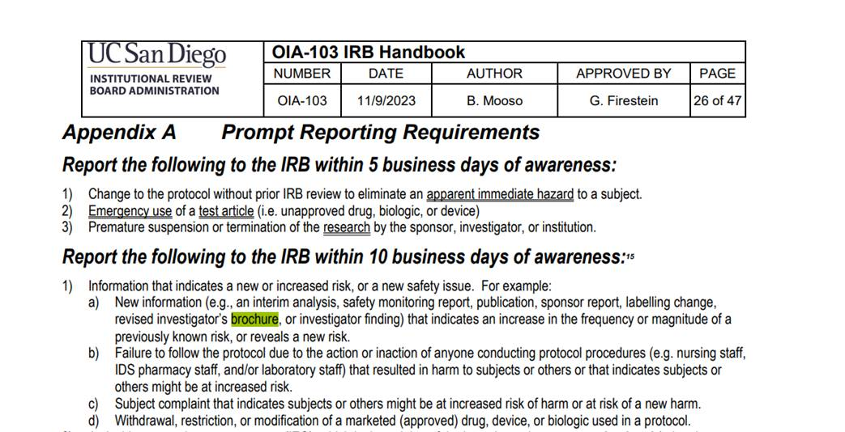
IB- HRP-103 - INVESTIGATOR MANUAL (ucsd.edu)

Slide 64
IB & IND
Does the FDA approve an investigator brochure?
For studies conducted under an investigational new drug application, an investigator's brochure is usually required by FDA [21 CFR 312.23(a)(5) and 312.55].
IND specialist submits the IB to the FDA at time of annual report.
Research Number:
  INVESTIGATOR’S BROCHURE
  Edition Number:
  Release Date:
  Replaces Previous Edition Number
  Date:

Slide 65
IB-Workflow
PI Receives the IB sent by sponsor via email
PI Review the IB- New Risks or Increase in other risks
PI forward IB within 24 hr to IND specialist and Reg Dept
FDA provides IND Approval or IND Exemption
IND Specialist/ Reg Dept submit to the IRB 10 days
Reg Dept Amends the ICF
30 days
PI & CRC
Discuss the new risks with the participant and re-consent subjects

Slide 66
IIT Auditing Plan
Arcadia L. Cruz, PhD

Slide 67
Audit Types
Full Audits
Defined as a complete and comprehensive review of all protocol-specific activities. These usually include review of the following components: regulatory, subject cases, and pharmacy records.
These include mock/preparatory audits, focused/process audits, for-cause audits, or Self/Anonymous audit requests
Mock or Preparatory audits are full audits to assist the PI and study team in preparation for a scheduled or anticipated inspection by the FDA, the National Institutes of Health, NCI, NCTN groups, ETCTN, study sponsors, or other regulatory authorities.
Self-requested or Anonymous audits can be made by a PI or disease team (e.g., the PI may be assuming the trial from a departing PI) or a member of the clinical research unit for a variety of reasons (e.g., departure of research staff, on-going findings during external site visits, etc.).
Process/Focused audits are reviews of internal systems and procedures. These are limited audits to assess compliance and/or reveal the need to change current practice (e.g., eligibility review, RECIST processes, etc.).
Off-cycle Audits
For-cause Audits
These will be performed when there are concerns or allegations of possible research misconduct potentially affecting subject safety or data integrity.

Slide 68
Compliance Auditing Plans
Conducting risk-based audits as per outlined procedures to ensure compliance with protocols and regulations.
Auditing the first patients and up to three additional patients accrued for any new CRC and DC.
2
4
Auditing the first patient and up to three additional patients consented and enrolled for any new PI or SI.
Managing and documenting audit findings, recommending corrective actions, and following up on their implementation.
1
3

Slide 69
Audit Frequency and Criteria:
Investigator-Initiated Trials (IITs)
ETCTN and NCTN Trials
Externally Authored IITs
For investigator-initiated trials, all sites, including UCSD, will be audited at 10% or a minimum of 2 cases per study, annually.
NCTN/ETCTN trials will be audited at least 10% or a minimum of 2 cases per study annually.
Externally authored IITs will be audited at 2 studies annually from each disease team, reviewing at least 1 case from each study, annually.

Slide 70
Conducting Audits: Who?
1
2
3
4
Audits will be conducted by UCSD –OCP auditors
Audits will include a comprehensive review of study documentation, regulatory compliance, and data integrity.
The auditors will issue an audit report detailing findings, recommendations, and corrective actions to be taken and communicated to the relevant stakeholders.
Corrective actions must be implemented within the specified timeframe.

Slide 71
CAPAs- Corrective Prevention Plans- KRI

Slide 72
Define CAPA - Corrective and Preventive Action Plan
Text
Text
Text
Text
Text
Text
Text
Text
Text
Text
Text
Text
Text
Text
Text
Text
Text
Text
Text
Text
Text
Text
Text
Text
Text
Text
Text
Text
Text
Text
Text
Text
Text
Text
Text
Text
Text
Text
Text
Text
Text
Text
Text
Text
Text
Text
Corrective Action
Preventative Action
Any action taken to eliminate the cause of an existing non conformity, defect or undesirable situation in order to prevent reoccurrence.
Any taken to eliminate the cause of and potential nonconformity.
1
2
Notes:
Correction Action is any action taken to eliminate the cause of an existing non conformity, defect or undesirable situation in order to prevent reoccurrence.
Preventative Action taken to eliminate the cause of an potential nonconformity
The purpose is to provide an system to assure the tracking and trending of issues requiring correction. The process will provide guidance on the requirements and use of the system and the procedures
Corrective and preventive action plans are linked to many fDA requirements
Revising, Replacing, Implementing, re education
The FDA looks for sites to have a policy on the process for CAPA

Slide 73
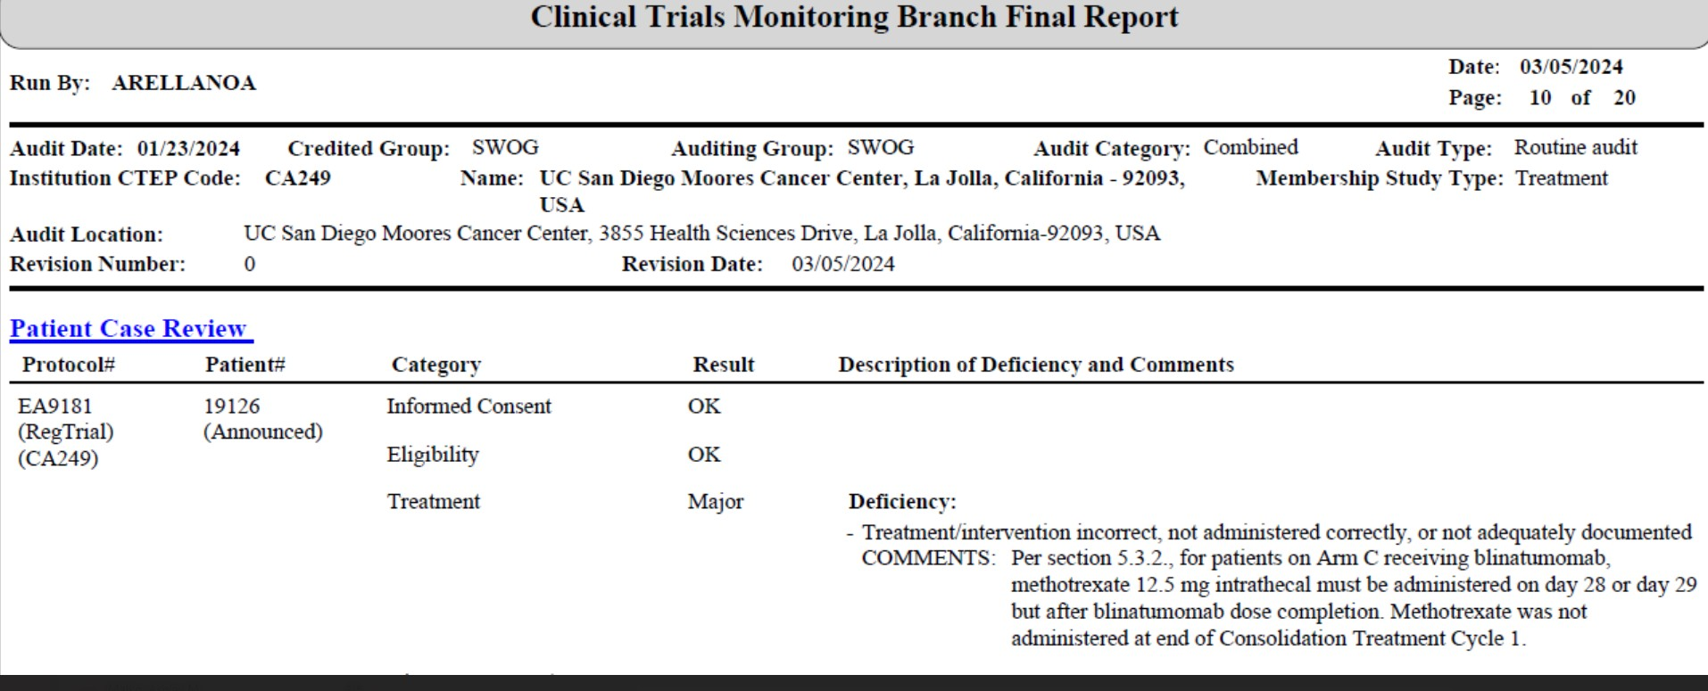
NCI- Cooperative Group –SWOG Audit Report

Slide 74
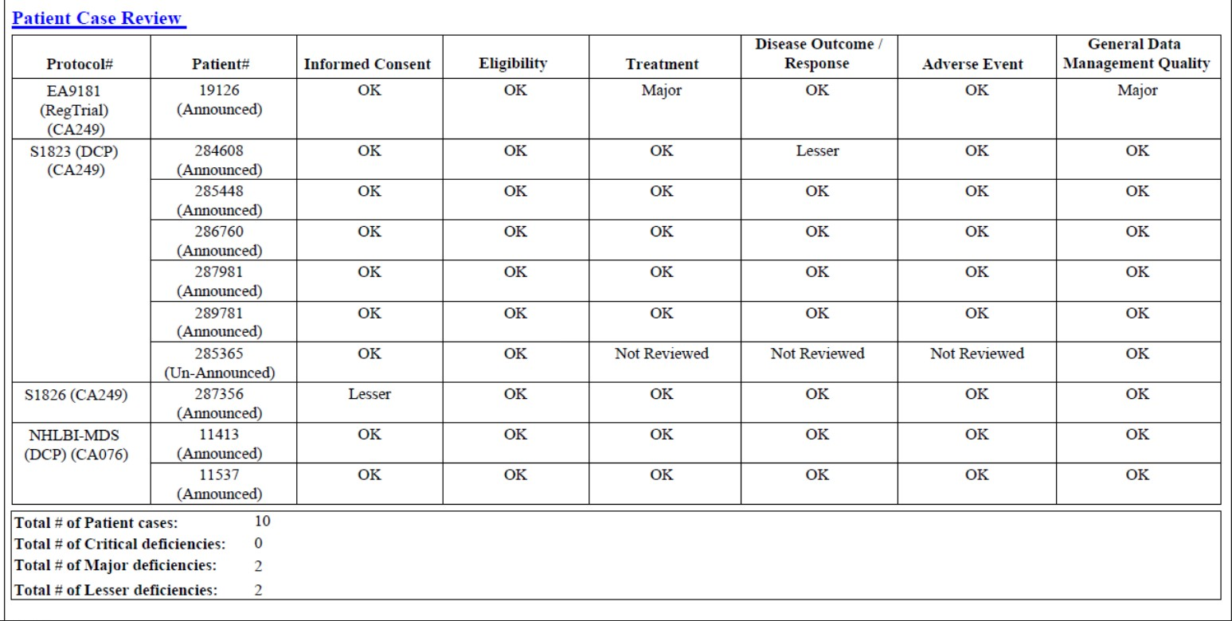
NCI Audit Report

Slide 75
Corrective and Preventive Actions
Identify
Review
Analyze
Institute New Process
Implement

Slide 76
Corrective and Preventive Action
Potential problems should be identified and steps taken to avoid them
1
2
Discovery of a problem should trigger an immediate corrective action
Development of a plan to prevent recurrences. A reevaluation of the system should be performed to ascertain how the problem occurred-Root cause
Documentation to avoid any questions from an auditor.
4
3

Slide 77
FY- 25 UC San Diego Health Compliance Program Work Plan
Moores Cancer Center (MCC) Clinical Trial Office (CTO) Research Compliance Plan | Description/scope needs are a WIP OCP will work to mitigate MCC CTO in the following areas: Monitoring of MCC CTO managed Investigator Initiated Trials (IITs) (including sub-sites) to support requirements of Cancer Center Support Grant for NCI designation. And monitoring of Co-Op studies, and new research staff managed studies. | High
AREA / PROJECT | DESCRIPTION / SCOPE
Moores Cancer Center – Clinical Trials Office (CTO) (Research Compliance) | Function: Mark and bold all that apply X Audit X Monitoring Consulting/Advisory/Process Implementation
 | Risk Description: The Moores Cancer Center Clinical Trials Office (CTO) has been identified as a high-risk area for conducting research. Processes are being identified and implemented to address non-compliance with regulations, UC San Diego Health Policies (UCSDHP), and best practices. However, protocol reviews and billing audits of the research conducted by the CTO are required to determine what measures, if any, are required to assure compliance. A lack of auditing specific to the CTO may result in ineffective processes and non-compliance. The risk areas were identified as: PI oversight Protocol deviations and protocol non-compliance, Reporting of adverse events (AE), and Clinical research billing. The OCP audits and reviews will focus on the above-mentioned risk areas and the mitigation strategies implemented to address the risk areas. Scope: A risk assessment has been conducted regarding the risk areas and focus of the OCP audits and reviews. The risk assessment will aid in developing the auditing and monitoring plan specific to the CTO. The results of the reviews conducted will be provided to leadership on a quarterly basis.

Slide 78
Takeaway Points- IITs Strong Oversight
01
02
03
Protect research participants, Regulatory compliance
Strengthens credibility
Quality Management is team effort
04
05
Continuous process
Education and improvement are vital

Slide 79
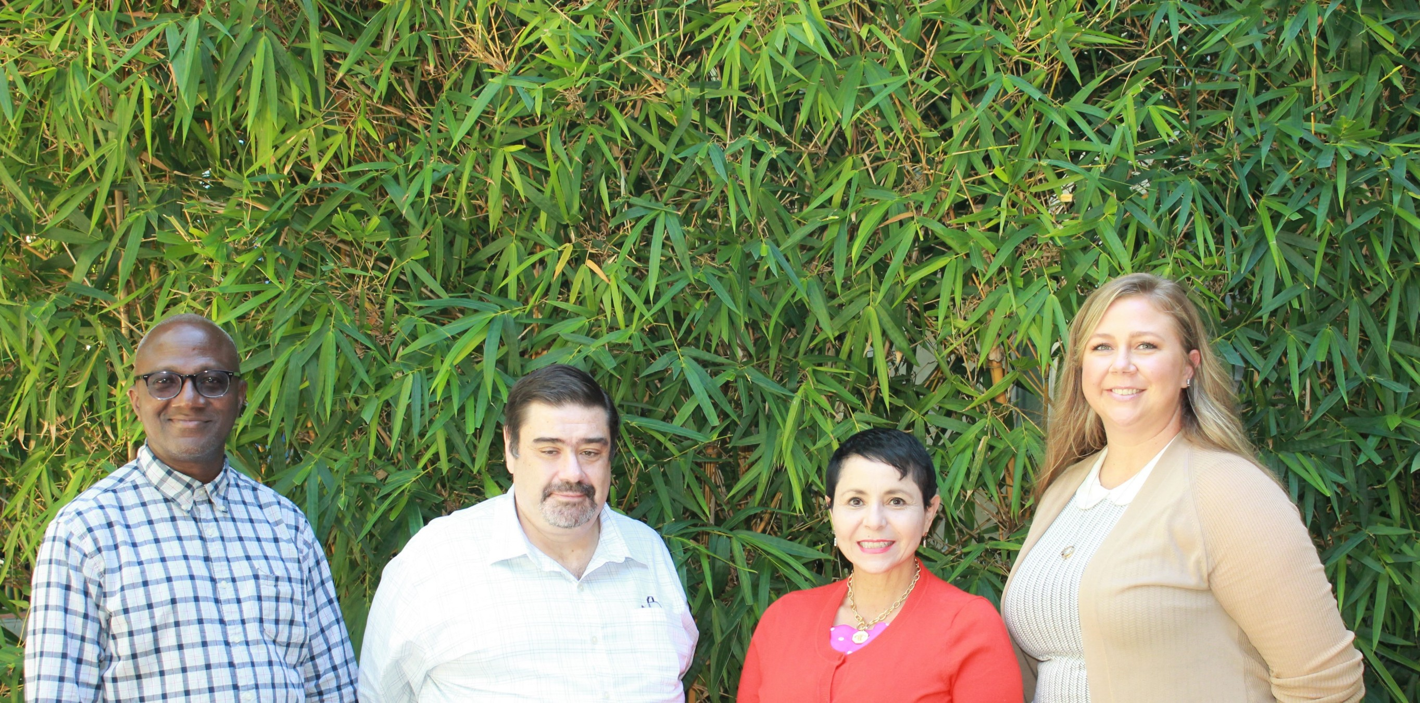
Research Compliance Team
Arcadia’s Cell #- 619-341-3634
Notes:
A combined experinece > 50 years.

Slide 80
Thank You

